Slide 1
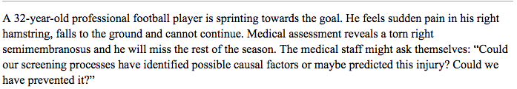
An ounce of prevention is better than a pound of cure
Reference :
“Tom Hughes et.al . Periodic Health Examination and Injury Prediction in Professional Football (Soccer): Theoretically, the Prognosis is Good. 2018; 48(11): 2443–2448. SPORTS MEDICINE”
Notes:
The phrase “an ounce of prevention is better than a pound of cure” is as relevant as never before.

Slide 2
What sports injuries really mean…?
Sports injuries don’t just cost wins. They cost money
It cost an elite European soccer team €20,000 (US$24,000) per day for every missing injured player
MLB spent $665 million in salaries, injured players and their replacements in one year (2013)
NBA teams lost $358 million in one season (2013)
NFL, where the average salary is about $2 million, starters missed a record 1,600 games (2013)

Slide 3
SPORT PERFORMANCE ANALYTICS
A fast-growing industry that can minimize massive losses.
Using data to anticipate how an athlete will get hurt before it actually happens.

Slide 4
SPORTS ANALYZED FOR INJURY PREDICTION
Ice hockey : one of the fastest of allsports
Baseball : most common injury suffered and is often caused by pitchers throwing too much.
Basketball: fourth leading cause of injury in team sports.

Slide 5
ANALYSIS OBJECTIVE
To analyze the different factors that influence a player’s potential to get injured
To develop a model that would accurately predict a player’s likelihood of being injured give his/her combination
of factors.

Slide 6
Process Workflow for NHL, MLB, NBA
Web scraping websites
Data wrangling
Tableau Visualization
Sklearn: Models Development

Slide 7
Resources for Scraping and creating datasets
NBA:
https://www.espn.com/nba/stats/player
https://stats.nba.com/players/bio/?Season=2018-19&SeasonType=Regular%20Season
https://www.kaggle.com/jaseziv83/extensive-nba-injuries-deep-dive-eda/report
NHL:
https://nhlinjuryviz.blogspot.com/2015/11/nhl-injury-database.html
http://www.espn.com/nhl/statistics/player/_/stat/timeonice/sort/avgTimeOnIce/year/2018
https://www.foxsports.com/nhl/players?teamId=0&season=2018&position=0&page=2&country=0&grouping=0&weightclass=0
MLB:
https://www.spotrac.com/mlb/disabled-list/

Slide 8
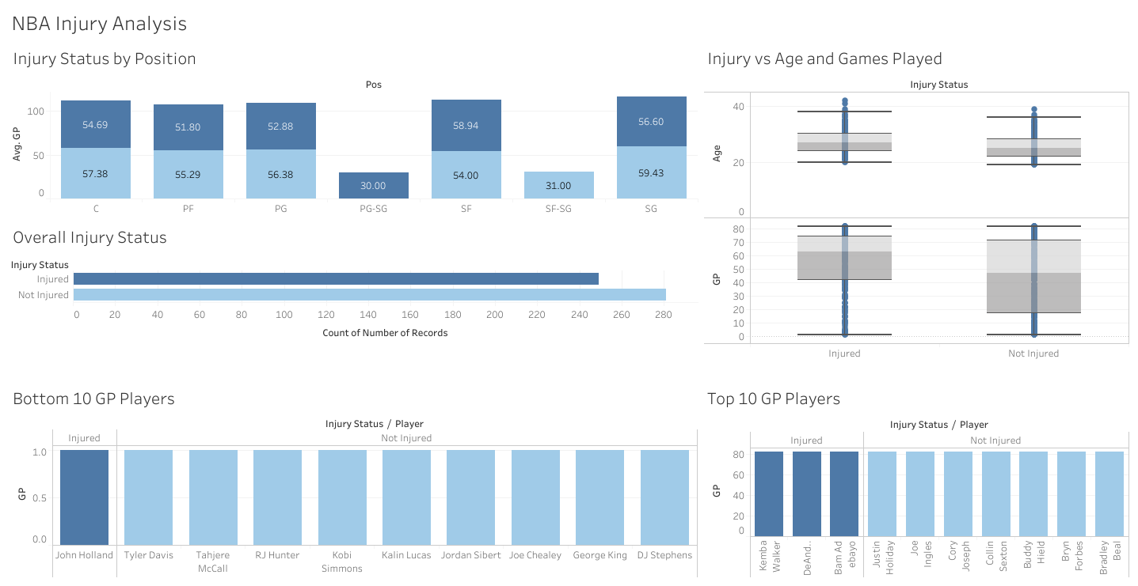

NBA in a Nutshell
Notes:
Out of 530 records, 47% injured and 53% not injured
There is no trend in terms of position played and number of games played for players. There is no significant difference between injured and non-injured, except for PG-SG all players are injured in that position
70 % of the top 10 players with highest number of games played are not injured while only 30% are injured
90% of the bottom 10 players with lowest number of games played are not injured

Slide 9
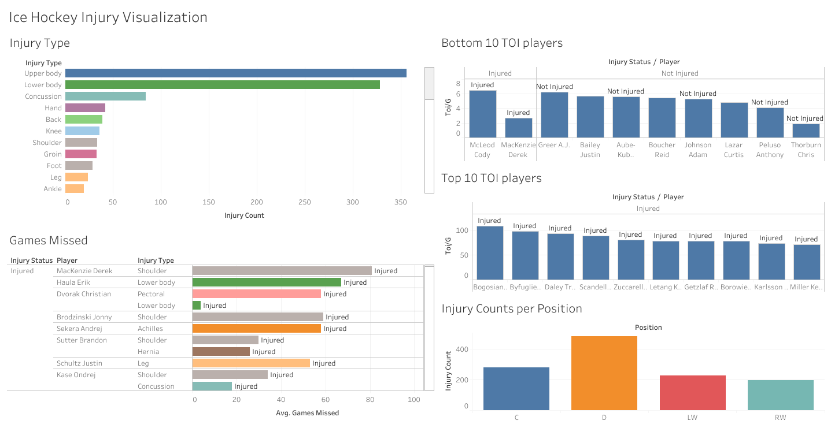
NHL in a Nutshell
Notes:
Out of 1082 records 55% injured
Most common injury type is Upper body followed by lower body and concussion
High number of missed games is due to injury
Top 10 players that spent most time on ice are all injured, while players with least amount of time are not injured in the majority
Defense position is highly prone to injury

Slide 10
MLB in a Nutshell

